Slide 1

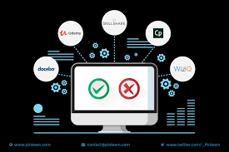
ONLINE EDUCATION PLATFORM
Web Application
PRESENTED BY
GUIDED BY
Dr.Jayasakthi Velmurugan.K
LAVANYA.R(192210663)
DHARSHINI.J(192210257)
PRADEESH GURU.A(192210636)

Slide 2


ABSTRACT
This presentation explores the key components and structure of online learning platforms.
It highlights the features that make e-learning accessible and flexible, such as interactive video lessons, quizzes, and progress tracking.
The technological framework, including frontend design, backend management, AI-driven personalization, and data analytics, is explained.
Additionally, the benefits of gamification, monetization models, and the challenges faced by these platforms are discussed.
The future of online learning with trends like AI, VR, and blended learning is briefly covered, showing how these platforms are transforming education.

Slide 3
.
OVERVIEW OF THE ONLINE EDUCATION PORTAL
Global Access
Provide education to learners everywhere
Skill Certification
Help users earn skills and certificates
Personalization
Tailor learning to individual needs
Flexible Learning
Allow self-paced, anytime learning
Engagement
Make learning interactive and engaging

Slide 4


THE EVOLUTION OF EDUCATION
Education has evolved from traditional classrooms to digital platforms. This shift allows for interactive learning experiences, making education more accessible and engaging for all students. Let’s explore the journey of this transformation.

Slide 5


INTRODUCTION
Online learning platforms have revolutionized the way education is delivered, making learning accessible to people anywhere and anytime.
These platforms offer a wide variety of courses across multiple disciplines, allowing learners to study at their own pace. With the rise of technology, e-learning has expanded beyond simple online courses to interactive, engaging experiences that include video lessons, quizzes, assignments, and peer collaboration.
Online education has become a crucial tool in bridging educational gaps, especially in today's fast-evolving, digital world. This presentation will explore the key features, technology, and future of online learning platforms.

Slide 6

EXISTING SYSTEM
LMS Platforms: Moodle, Canvas (structured course management).
MOOCs: Coursera, edX (university-level courses, certificates).
Interactive Platforms: Udemy, Khan Academy (video-based, self-paced).
Social Learning: Google Classroom, MS Teams (collaborative tools).
Gamified Apps: Duolingo (uses points and rewards for motivation).

Slide 7
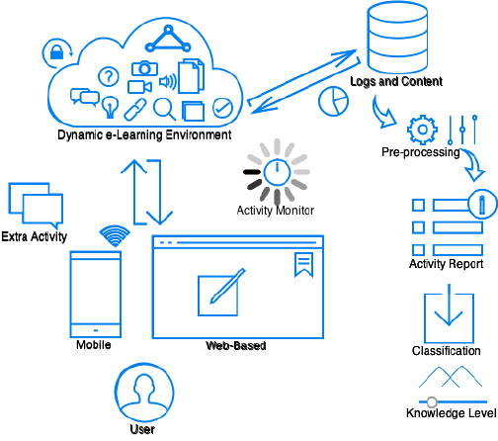
ARCHITECTURE DIAGRAM

Slide 8

PROPOSED FEATURES
AI-Powered Suggestions: Content based on user progress.
Detailed Analytics: Better progress insights.
Immersive AR/VR: Real-world simulations in VR.
24/7 Support: Chatbots for instant help.
Microlearning: Short, modular courses.
Community Support: Peer interaction and mentoring.
Offline Access: Downloadable courses for limited internet.
More Gamification: Points, badges, and leaderboards.

Slide 9
TRADITIONAL VS MODERN LEARNING
TRADITIONAL LEARNING
MODERN (ONLINE) LEARNING:
Classroom-based: Students attend physical classes with face-to-face interaction between teachers and peers.
Fixed Schedule: Lessons follow a strict timetable, with limited flexibility for learners.
One-size-fits-all Approach: Teaching methods are standardized for all students, regardless of individual learning needs.
Flexible and Accessible: Learning can take place anytime, anywhere, with courses available online for self-paced study.
Personalized Learning: AI-driven platforms provide personalized recommendations and adaptive learning paths based on user performance.
Diverse Resources: Access to a vast library of digital content, including videos, interactive tools, and global knowledge databases.

Slide 10
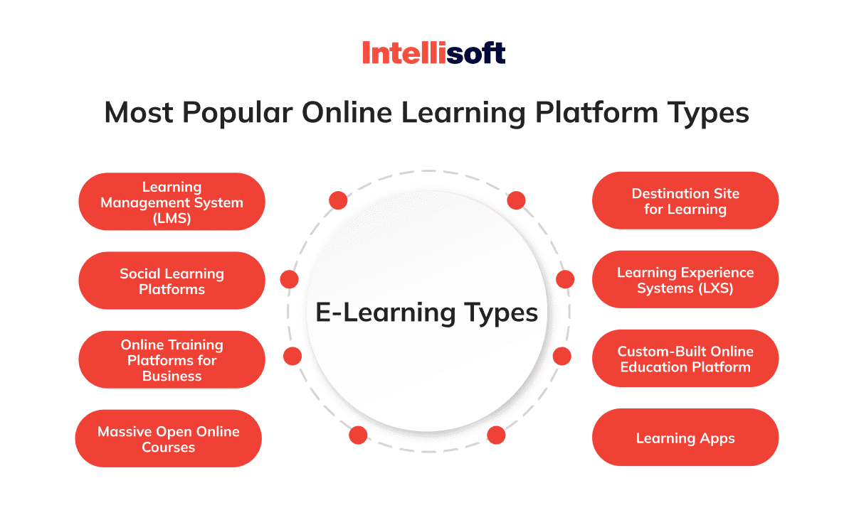
ONLINE LEARNING PLATFORM TYPES

Slide 11
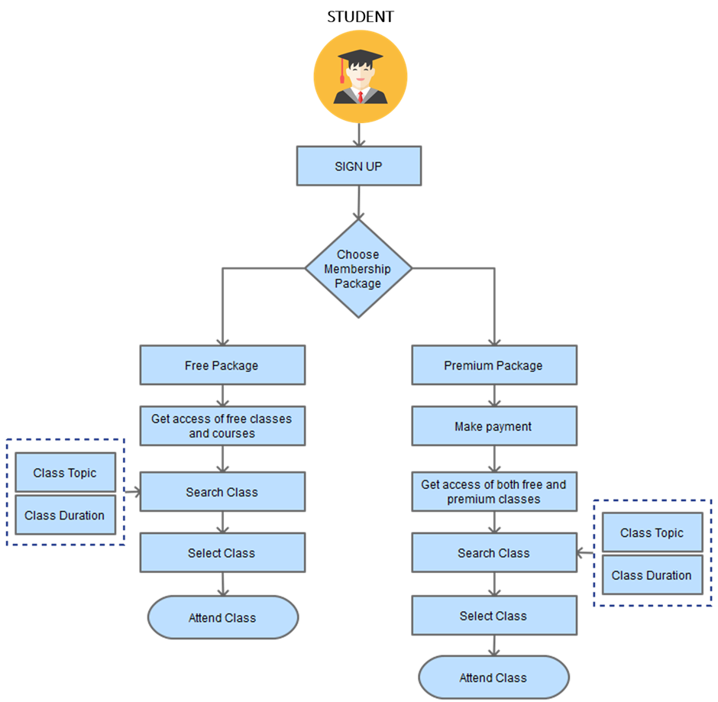
FLOWCHART
This flowchart illustrates the user journey for an online learning platform

Slide 12
PROCESS FOR BUILDING AN ONLINE LEARNING PLATFORM
1. Set Up Environment
Install XAMPP (includes Apache, PHP, MySQL).
Start Apache and MySQL using XAMPP.
2. Create Database
Open phpMyAdmin from XAMPP.
Create a database (e.g., online_learning).
Create tables:
Users (for user details).
Courses (for course information and enrollment).
3. Design Front-End (HTML)
Create HTML forms for:
Registration (username, password).
Login (username, password).
Course enrollment.
4. Back-End (PHP)
Write PHP scripts to:
Handle user registration (save details in the database).
Handle login (verify user and password).
Manage course enrollment (save selected courses for users).
5. Test the Application
Test registration, login, and course selection.
Ensure data is stored in the database properly.
6. Deploy
Run the platform on Apache and ensure database connections work.
This creates a simple web application for an online learning platform.

Slide 13
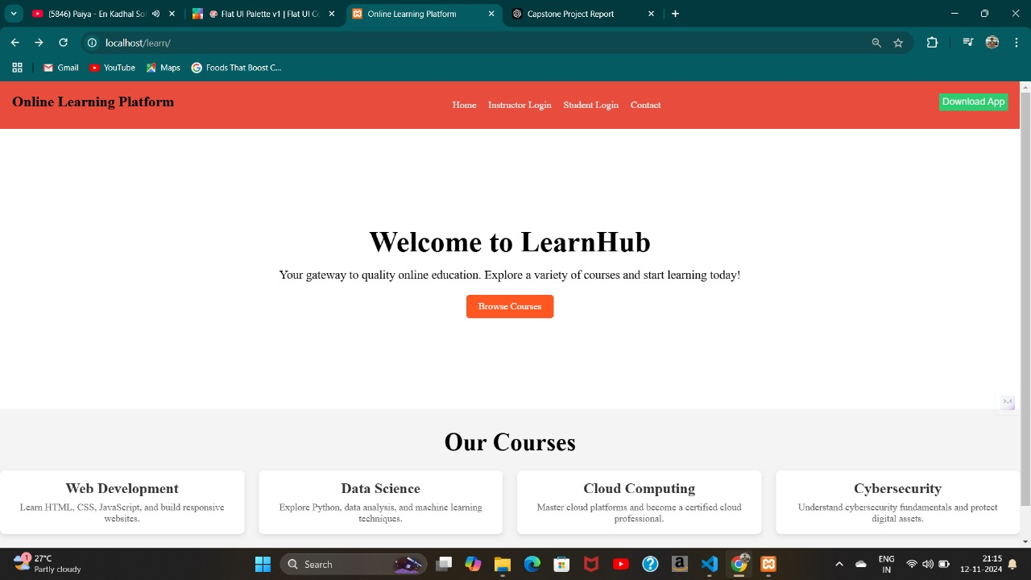
WEB APPLICATION BASED ONLINE LEARNING PLATFORM
.
TURNOUT IS HERE

Slide 14
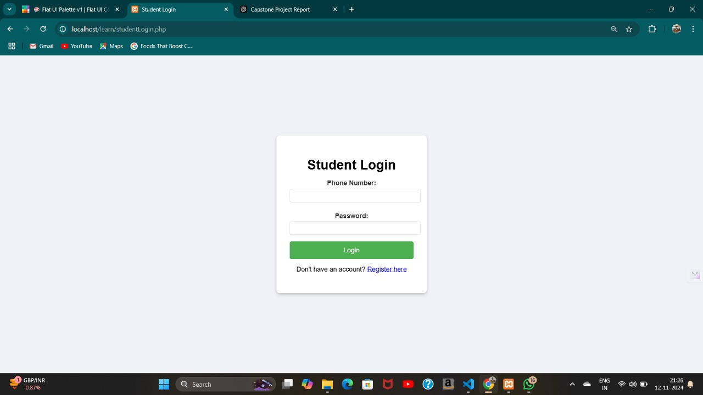

Slide 15
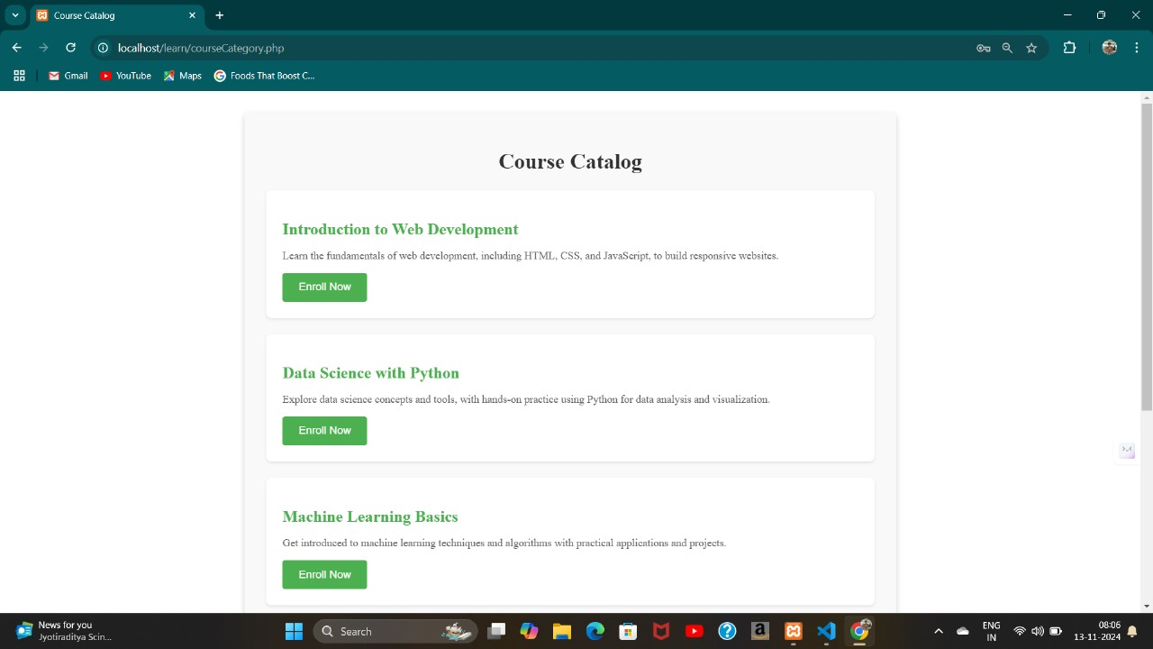

Slide 16
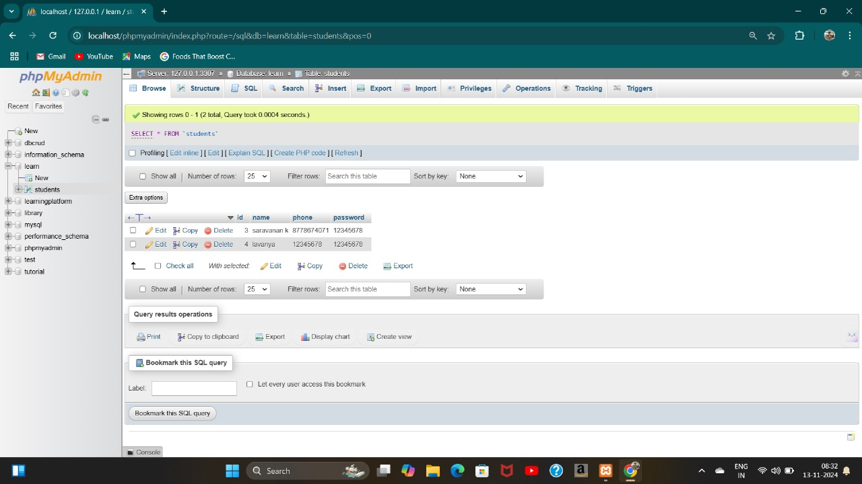

Slide 17


ADVANTAGES
Flexibility: Learn anytime and anywhere, accommodating different schedules and learning paces.
Personalization: Adaptive learning paths and recommendations tailored to individual student needs.
Cost-Effective: Eliminates the need for commuting and printed materials, reducing costs for learners and institutions.
Global Reach: Enables learners to access world-class education from anywhere, breaking down geographical barriers.
Diverse Content: Offers multimedia learning resources such as videos, quizzes, and interactive tools that enhance learning experiences.
.

Slide 18

FUTURE ENHANCEMENT
AI-Driven Personalization: Advanced AI algorithms will further customize learning experiences by analyzing user data in real time.
Virtual Reality (VR) and Augmented Reality (AR): Immersive technologies will create more interactive and practical learning environments, such as virtual labs and field trips.
Blended Learning Models: Combining online and offline methods to offer a more comprehensive learning experience.
Microlearning: Bite-sized lessons tailored to suit busy schedules and increase engagement.
Blockchain for Credentialing: Using blockchain to securely verify and store certifications and learning achievements.

Slide 19

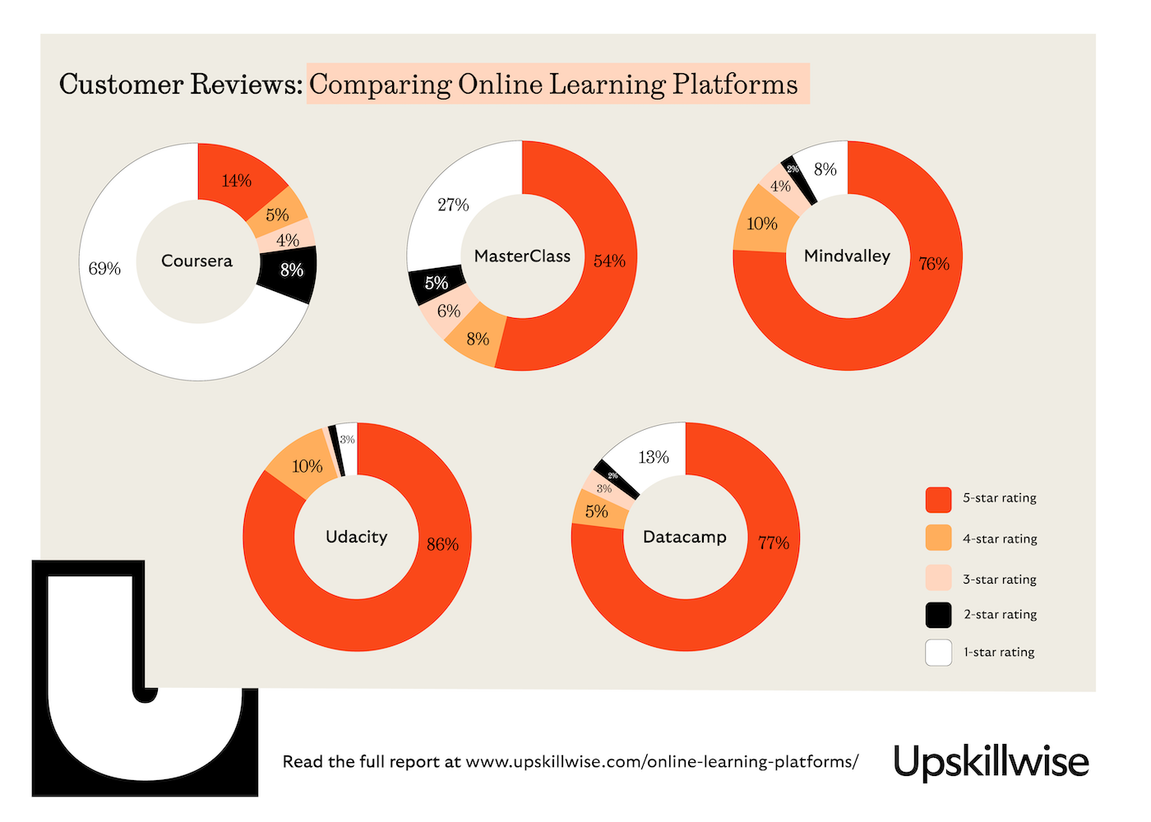
CONCLUSION
Online learning platforms have reshaped education by providing flexible, accessible, and personalized learning experiences.
With advancements in technology, these platforms will continue to evolve, offering more immersive, adaptive, and engaging methods of teaching.
The future of online education looks promising, integrating AI, VR, and gamification to better meet learners' needs.
This transformation will play a crucial role in making quality education available to everyone, regardless of location or background.

Slide 20
REFERENCES
Anderson, T., & Dron, J. (2011). Three Generations of Distance Education Pedagogy. International Review of Research in Open and Distributed Learning.
Means, B., Toyama, Y., Murphy, R., Bakia, M., & Jones, K. (2009). Evaluation of Evidence-Based Practices in Online Learning: A Meta-Analysis and Review of Online Learning Studies. U.S. Department of Education.
Pappas, C. (2019). The Future of Online Learning: Trends and Predictions. eLearning Industry.
Picciano, A. G. (2017). Theories and Frameworks for Online Education: Seeking an Integrated Model. Online Learning Journal.
Siemens, G. (2005). Connectivism: A Learning Theory for the Digital Age. International Journal of Instructional Technology and Distance Learning.

Slide 21

ANY QUERIES…?tt
THANK YOU..!!

